Slide 1
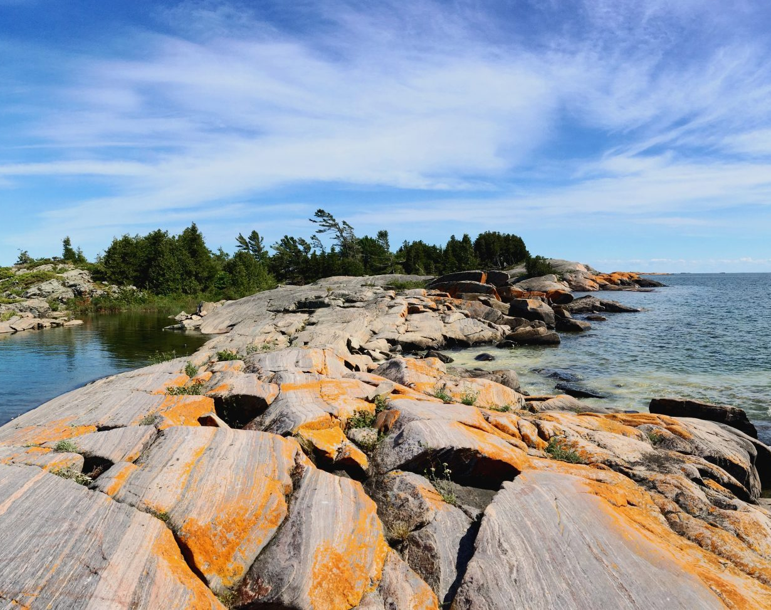
Training Session:
2026 Water Quality Monitoring Program
Township of Georgian Bay
Presented by:
Kim Schiefer, M.Sc.
May 16, 2026
This Photo by Unknown Author is licensed under CC BY-SA-NC

Slide 2
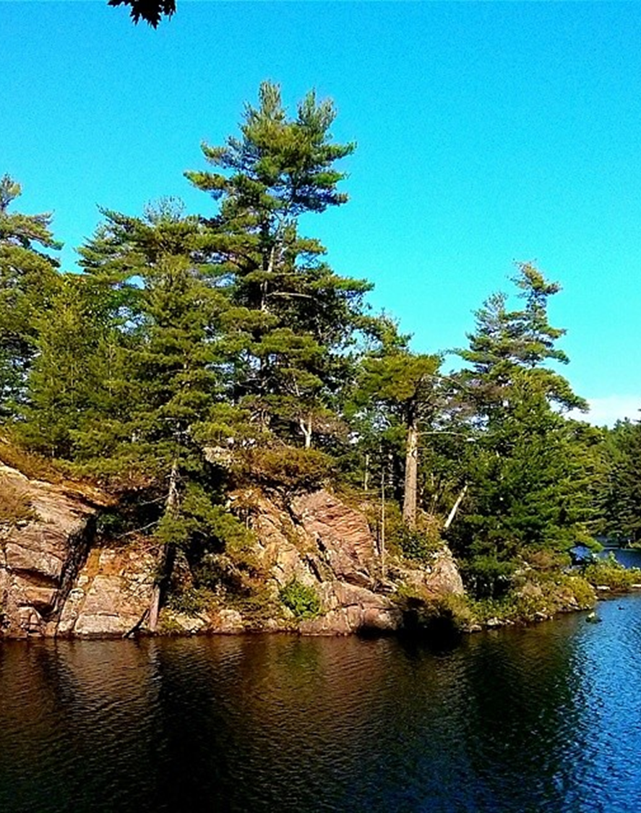
Introduction:
We’re all here because we share a deep connection to Georgian Bay and the inland lakes
By volunteering for this program, you’re becoming lake stewards, helping to protect these waters through observation, monitoring, and science-based data collection
Today’s training will give you the tools and knowledge to monitor water quality, consistently, and effectively

Slide 3
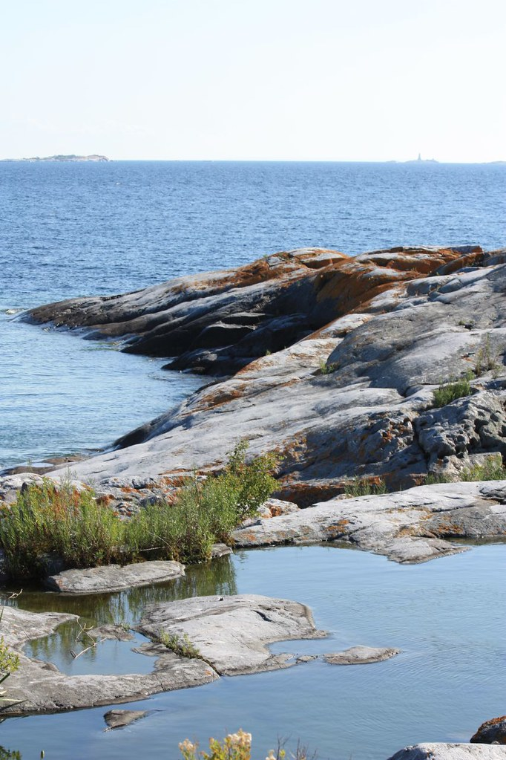
Today’s Training Session:
Brief introduction
The bigger picture: why water quality monitoring matters in Georgian Bay and our inland lakes
Discuss past monitoring efforts and what we’ve learned
Review the parameters we’ll be monitoring
Sampling and analysis procedures and data collection
Best practices for consistent and reliable results
Ultimate goal: “Observation to Action”
Finish with a hands-on demonstration of the ColiPlate™ technique used to analyze water samples for bacterial contamination
This Photo by Unknown Author is licensed under CC BY-NC-ND

Slide 4
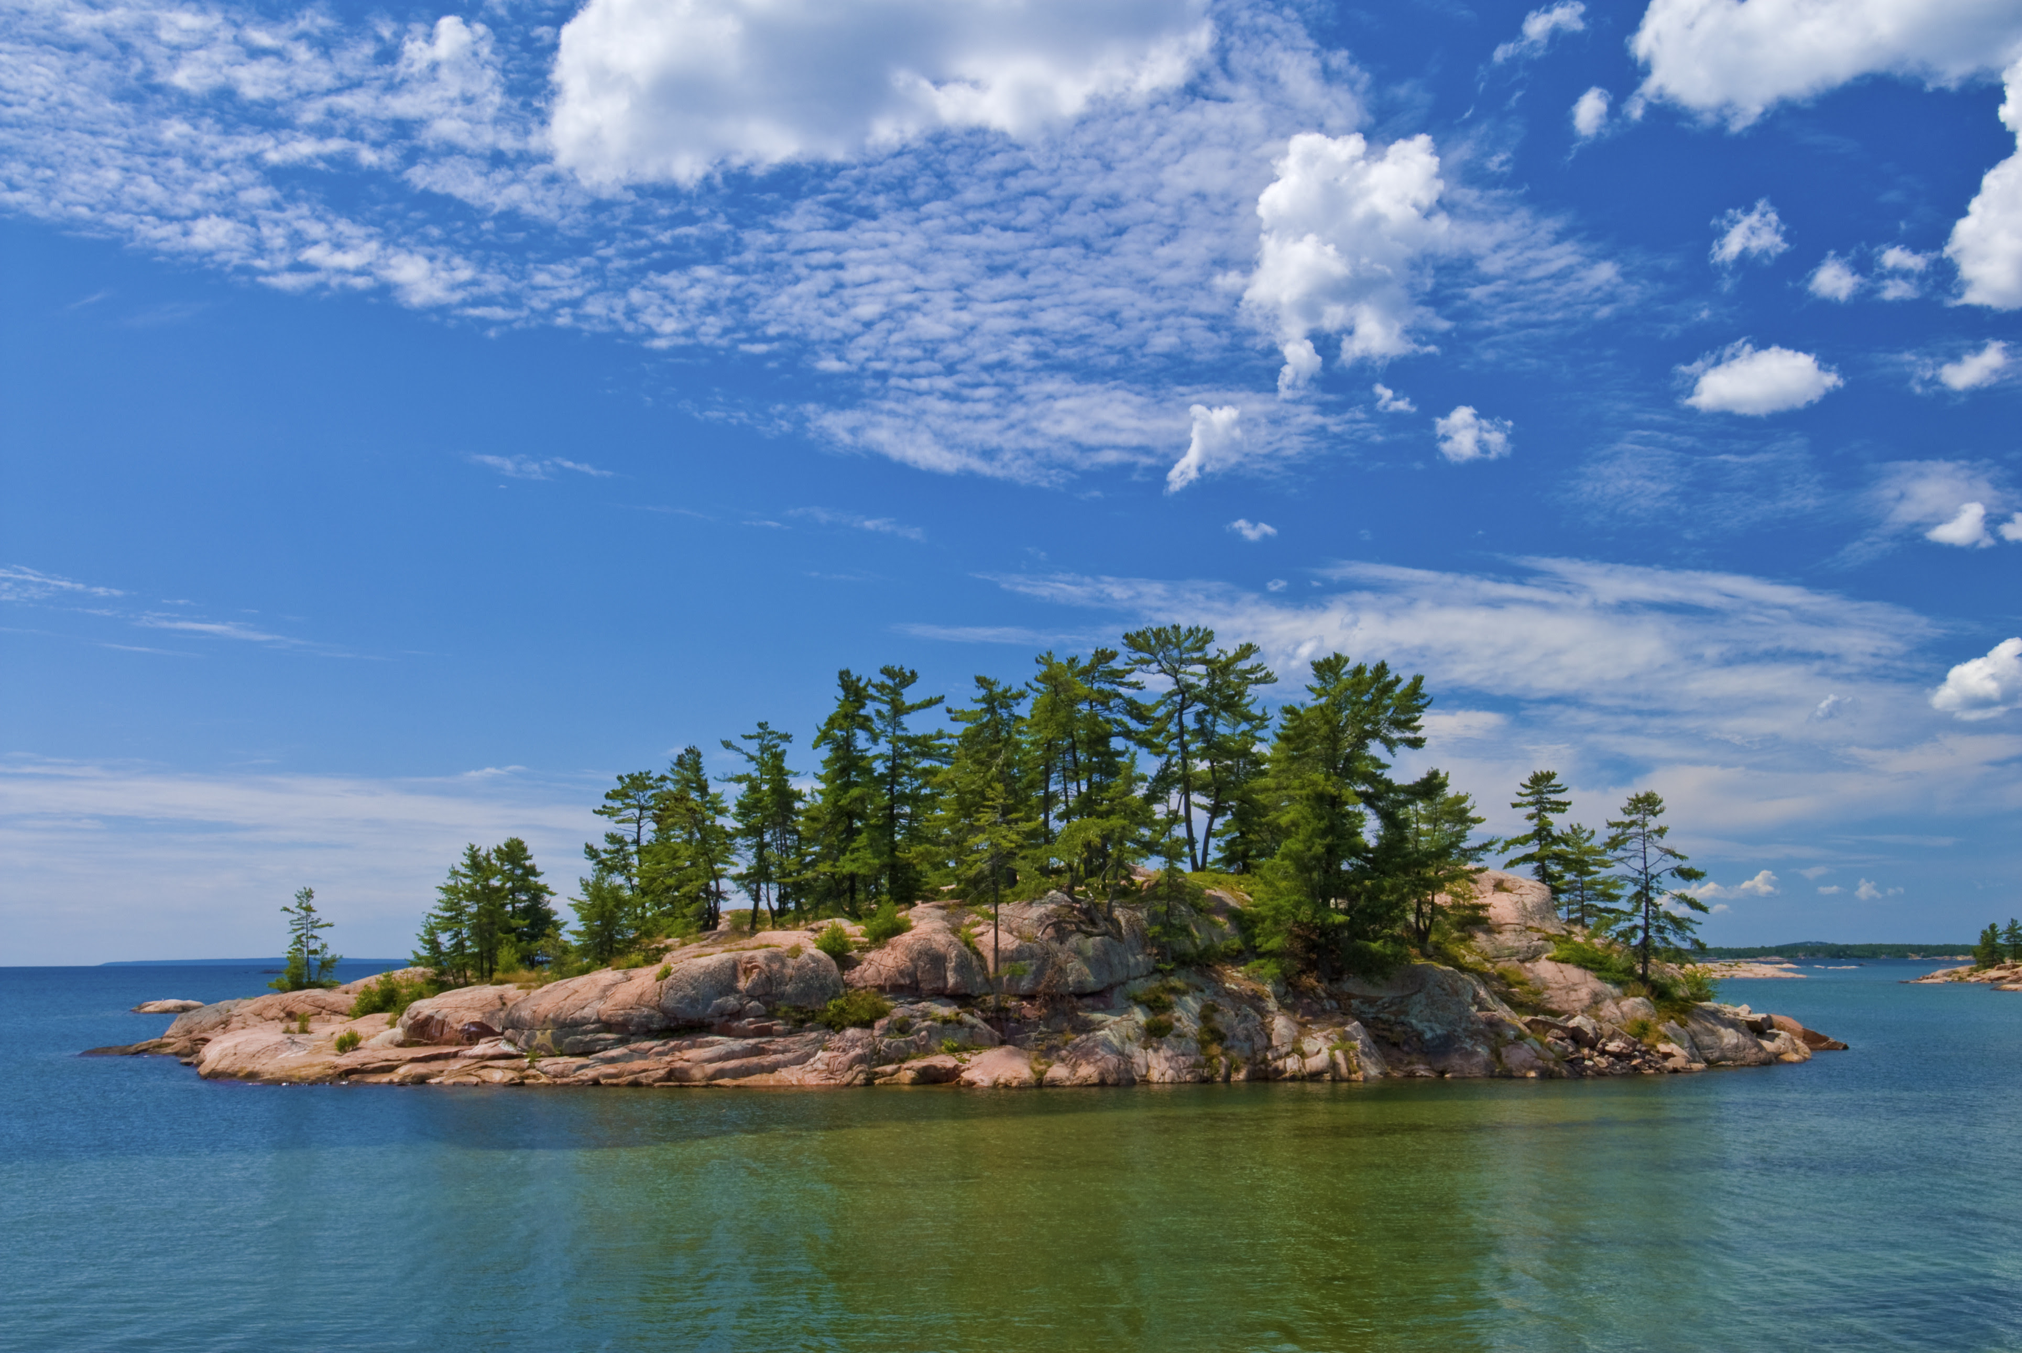
Background:
Kim Schiefer
Lifelong connection to Georgian Bay
University of Guelph, M.Sc.
Bacteriological water quality nearshore waters Georgian Bay
Volunteer Water Quality Monitoring Program
Bluewater Biosciences Inc.
Program Manager - Water Quality Monitoring Program
This Photo by Unknown Author is licensed under CC BY

Slide 5
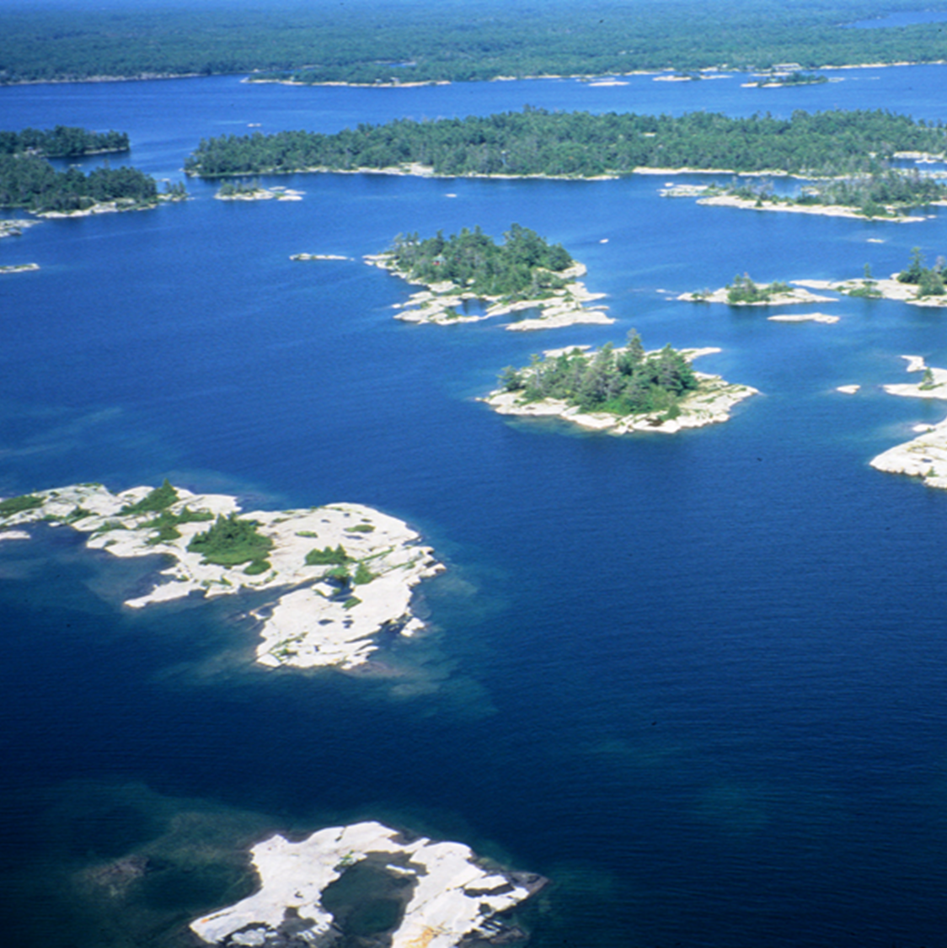
Introduction:
The Township of Georgian Bay is defined by water
  Vast shoreline and archipelago of coastal Georgian Bay
  To the countless inland lakes, rivers and wetlands
Water shapes the region’s landscape, lifestyle, and economy
Not only the Township’s most prominent natural feature, but also its most valuable resource

Slide 6
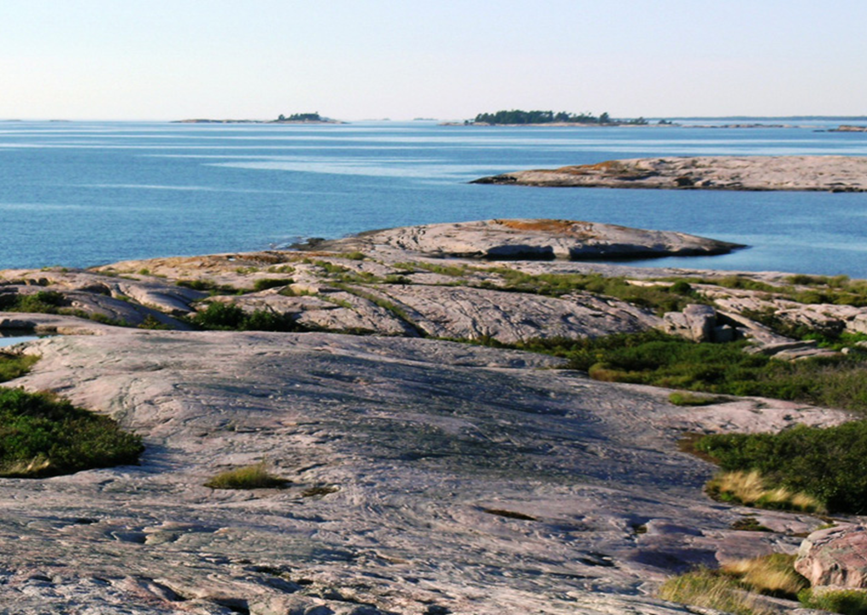

Georgian Bay and the Inland Lakes face distinct and unique water quality challenges
The magnitude and number of environmental stressors are increasing (intensification of shoreline development and overall human activity)
There is a need for high quality, long-term data to support effective science-based management of this freshwater ecosystem

Slide 7
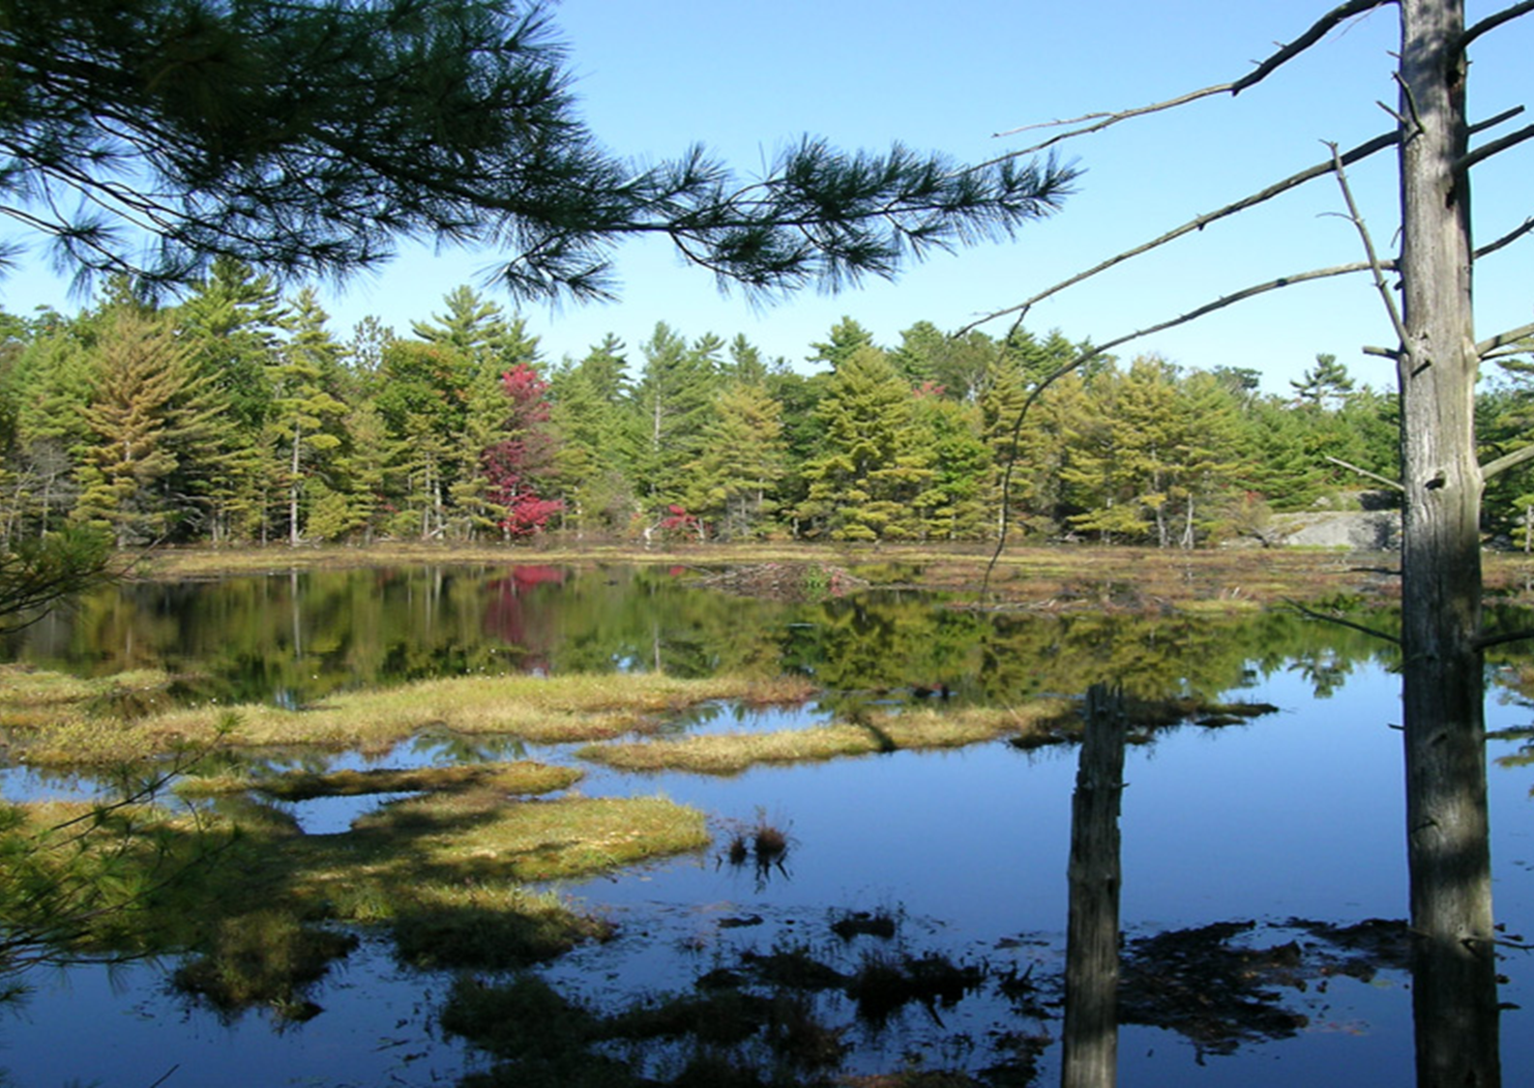
Township of Georgian Bay (TGB):
Has supported community and volunteer-based water monitoring programs for 25 years
Thousands of samples have been analyzed for chemical and bacterial indicators throughout the TGB
“What have we learned and how are we using this knowledge to shape future monitoring efforts”

Slide 8
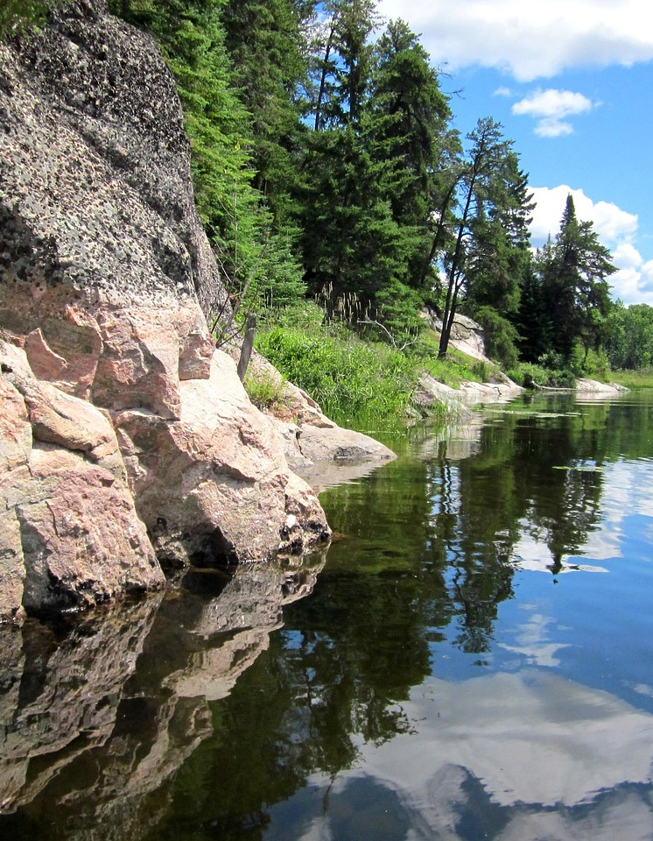
What Have We Learned:
Chemical Parameter: Total Phosphorus (TP)
Primary limiting nutrient for algae growth in freshwaters
High TP levels can trigger excessive algae blooms, reducing water clarity and oxygen
Natural Background Levels: low due to influence of Precambrian Shield
Levels in the open waters of Georgian Bay are typically low at 3 - 5 µg/L
Levels in the inland lakes are below or around 10 µg/L
Lakes within TGB are naturally oligotrophic
Eutrophic states linked to anthropogenic inputs and shoreline development as opposed to natural inputs (Chow-Fraser, 2024)
Changes in TP seasonal trends:
  Historically early spring TP levels being the highest
  Now observing elevated levels later in the season
  Climate change, warmer water temperatures, higher density development

Slide 9
What Have We Learned:
Bacterial Parameters: Total Coliform (TC) and E. coli (EC)
Indicator bacteria are monitored in water to assess the presence and level of fecal contamination and determine the safety of recreational water
Indicator bacteria themselves not cause of illness however their presence in high concentrations suggests a high probability that disease causing pathogenic organisms are also present
EC is innocuous and it is easy to culture
EC is the primary indicator used by Health Canada as it is solely from fecal sources (TC is found in soil/vegetation sources)
Natural Background Levels:
    Background levels in Georgian Bay and Inland Lakes < 5 CFU/100mL
    Elevated E. coli levels directly related to the density of shoreline development and intensified human activity
Creation of the Georgian Bay Water Quality Objective (GBWQO)

Slide 10
Creation of Georgian Bay Water Quality Objective (GBWQO)
Provincial Guidelines suitable for highly urbanized regions where water impairment has already occurred
Given the high-quality waters of Georgian Bay and the Inland Lakes a more stringent Water Quality Objective for Phosphorus and E. coli has been adapted

Slide 11
Regulatory Standards vs. GBWQO: Total Phosphorus (TP)
Objective | TP Threshold | Goal
Provincial Water Quality Objective (PWQO) | < 20 µg/L | To prevent a lake from becoming eutrophic (algae blooms)
Georgian Bay Water Quality Objective (GBWQO) | < 10 µg/L Georgian Bay < 15 µg/L Inland Lakes | To maintain a natural, oligotrophic state Clear water, high oxygen levels in deep water, and limited algae growth

Slide 12
Regulatory Standards vs. GBWQO: E. coli
Objective | E. coli Threshold | Goal
Provincial Recreational Water Quality Guideline | < 200 CFU/100mL | This concentration represents an acceptable threshold of health risk at public beaches
Georgian Bay Water Quality Objective (GBWQO) | < 10 CFU/100mL | To protect and maintain the high-quality waters in this region

Slide 13
Expansion of Water Monitoring Program in 2026 includes:
  Add underrepresented regions:
    From the most northern region of the TGB including Twelve Mile Bay, Wah Wah Taysee, Go Home Bay and Cognashene (boat anchorage bays)
    To the most southern region of the TGB, Port Severn
  3 seasonal Total Phosphorus sampling events will be completed
    Investigate apparent change in TP seasonal trends
    Evaluate temporal variability
  5 seasonal E. coli sampling events will be completed
    Adhere to Provincial Sampling Requirements - minimum of 5 E. coli samples, for effective seasonal Geometric Mean
  Opportunity validate TGB Program results with parallel Lake Partner testing (Go Home Lake)
  Additional parameters: Secchi depth and temperature

Slide 14
2026 Program and the Water Quality Working Group (WQWG)
2026 Water Quality Monitoring Program is guided by the WQWG
WQWG includes members with expansive scientific, technical and local expertise
Focused on broadening the scope and impact of the 2026 Program
The WQWG providing program development support and expertise on scientific, geographic, and technical issues related to sampling, analysis, and quality assurance

Slide 15
Water Quality Working Group (WQWG) – 13 Members
Program Leadership | Position | Expertise
Kim Schiefer | Program Manager | Environmental Consultant
Caely Nicholson | TGB Staff Member | CBCO, Chief Building Official
TGB Council Members | Ward | Position
Peter Cooper | Wards 2 & 4 | District Councillor
Allan Hazelton | Ward 4 | Area Councillor
Kristin Graziano | Ward 3 | Area Councillor
Steven Predko | Ward 1 | Area Councillor
Regional Representatives | Region / Association | Expertise
Winanne Grant | Honey Harbour Association | President of the H.H Association
David Flower | Oak Bay / Port Severn Resident | Land Trust Steward and Volunteer
Cindy Gilmore | Gloucester Pool | Bio-geochemist
Jim Rusak | Go Home Bay | MECP Dorset – retired scientist
Sandy Thompson | Cognashene Cottagers’ Association | Environmental Consultant
Jack Giroux | Cognashene Cottagers’ Association | GIS Technician, G.B Forever
Simon Edwards | Go Home Lake Cottagers’ Association | Volunteer and Steward – 40 years

Slide 16
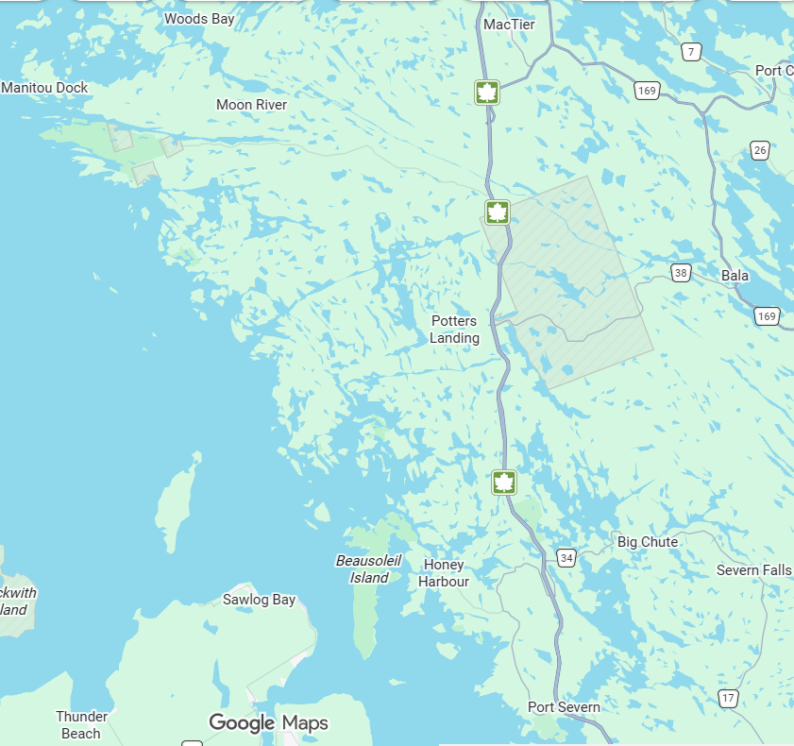
Stewart Lake
2026 Water Quality Monitoring Regions
Inland Lakes:
Gloucester Pool
Severn River
Six Mile Lake
Gibson Lake
Go Home Lake
Myers Lake
Stewart Lake
Coastal Georgian Bay:
Oak Bay
Honey Harbour (North and South)
Cognashene (Area 1 and Area 2) - NEW
Go Home Bay - NEW
Wah Wah Taysee - NEW
Twelve Mile Bay - NEW
Port Severn - NEW
Myers Lake
Twelve Mile Bay
Wah Wah Taysee
Go Home Lake
Go Home Bay
Gibson Lake
Cognashene
Six Mile Lake
Severn River
Honey Harbour
Gloucester Pool
Oak Bay
Port Severn

Slide 17
Water Quality Parameters Monitored:
Parameter | Measurement Method | Sources | Provincial Guideline | Georgian Bay Water Quality Objective (GBWQO) | Elevated levels indicate:
Total Coliform | ColiPlate™ | Wildlife, wetlands, vegetation/soil | N/A <1000 MPN/100mL** | N/A | Naturally occurring, biological activity
E. coli | ColiPlate™ | Fecal sources: sewage, agriculture, wildlife, boat discharge | < 200 MPN/100mL | <10 MPN/100mL | Fecal contamination, decline in recreational water quality
Total Phosphorus | Samples submitted to lab for analysis (SGS) | Sewage, storm water, agriculture, soaps, fertilizers | <20µg/L | <10µg/L Georgian Bay <15µg/L Inland Lakes | Eutrophication (excessive algae and plant growth), harmful to fish populations
Clarity | Secchi Disk | Sewage, storm water, agriculture, soaps, fertilizers, boat activity, shoreline erosion | N/A | >4m Georgian Bay >3m Inland Lakes | Eutrophication, shoreline disturbances/erosion
Temperature | Digital thermometer |  | N/A |  | Climate Change

Slide 18
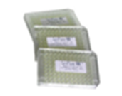
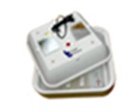
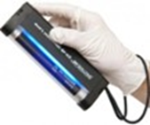


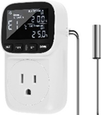
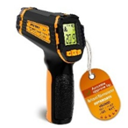

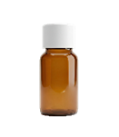

Equipment to be provided:
ColiPlates
Incubator
UV light
Sample Bottles
Gloves
Incubator Temp Control
Digital Thermometer
Secchi Disk
Phosphorus Sample Bottles
Waterproof Sharpie
Volunteers, please provide a cooler large enough to hold all samples and ice packs

Slide 19
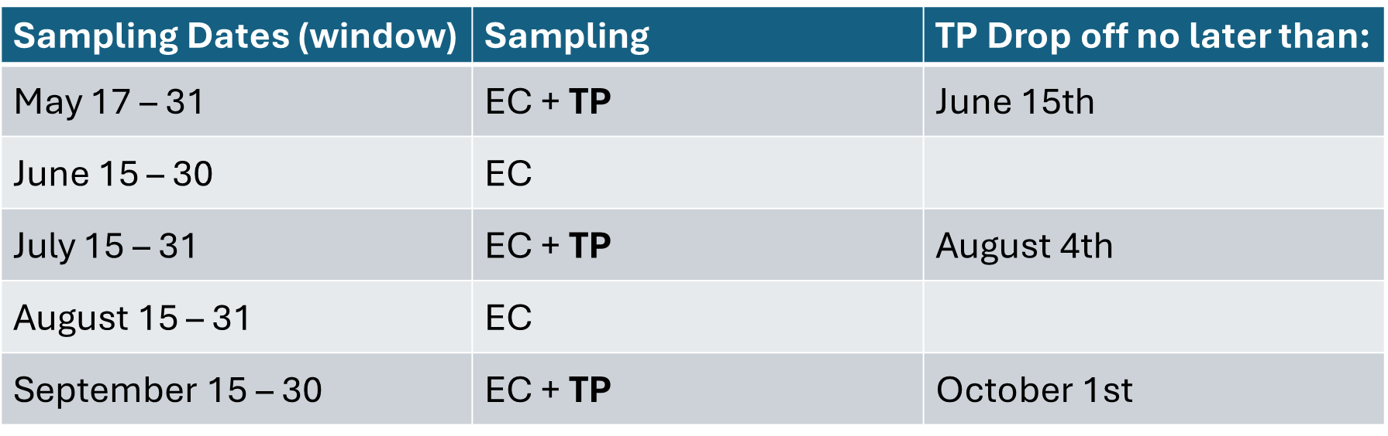
Monitoring Program Design:
Sampling Sites
Regions continuing in program please continue to sample the same sites
Twelve Mile Bay, Wah Wah Taysee, Cognashene, Go Home Bay and Port Severn – sites to be discussed
Once sites are determined clearly identify on map and determine GPS coordinates
Use standard sample ID format (for example HH01 is Honey Harbour Site 1)
Sampling Schedule

Slide 20
Sampling Timing
Chemical and bacterial testing is most informative after major rainfall, giving insight into the impact of overland flow and storm water runoff
Testing after peak usage times such as Sunday or Monday
Before 10 a.m. as solar radiation can kill bacteria
Sample Bottles
500mL plastic (i.e. laboratory grade Nalgene sample bottles which can withstand boiling water) sampling bottles have been provided for phosphorus and bacterial sample collection.
Each bottle should be labelled with the sampling site ID number and always re-used for the same site. Use the waterproof sharpie provided.
Sterilize the bottles after use by placing them in boiling water for several minutes and air-dry on a clean rack.
Seal bottles with lids and set aside for the next sampling date.

Slide 21
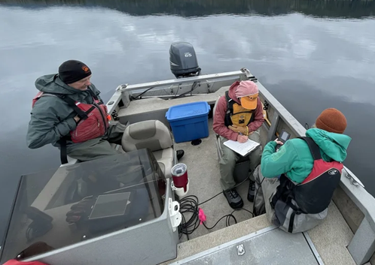
Sample Preparation:
Before setting out by boat:
Make sure you have all required safety and sampling equipment and fill out data sheet
Consult the map of your sampling area and arrange your sampling bottles accordingly.
Approach each site using the determined GPS coordinates
Please be careful not to stir up bottom sediment with the boat, using an anchor, if necessary
Using the digital thermometer on the shady side of the boat, record water temperature
Collect water samples and record Secchi depths

Slide 22
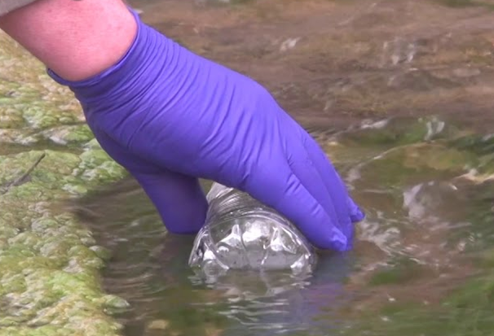
Sampling Procedure:
Please ensure clean hands, rinsing at each site to remove any sunscreen and soap/lotion (gloves may be worn if preferred).
Be careful not to touch the mouth of the bottles and inside caps.
Rinse bottle out several times using water at the sampling site prior to collecting water.
The water sample should be collected from just below the water surface (around elbow depth or 10 inches).
Grip the bottle at the base and plunge it in a downward motion, using the “plunge and sweep” method.

Slide 23
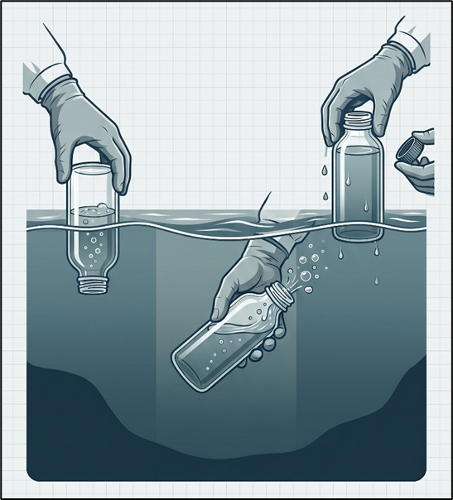
Sampling Procedure:
Plunge and Sweep Method
Plunge the sample bottle mouth-down vertically into the water to prevent surface film from entering the bottle.
Tilt and sweep the submerged bottle forward, allowing the air to escape and the water to fill the bottle from desired depth.
Raise the filled bottle vertically out of the water column to complete the collection process.

Slide 24
Total Phosphorus Sample Collection:
Prepare phosphorus bottles by labeling them with each site number. The TP bottles have preservative in them (0.5 ml of 50% nitric acid), please do not rinse these bottles.
Rinse 500 mL sample bottle with water at the site several times. Collect a water sample using the “plunge and sweep” method. Use the sample bottles for TP collection first.
Pour water into the Phosphorous sample bottle, please be careful not to touch the inside of the bottle or cap. Fill to the ‘fill line’ (shoulder of bottle) and screw the lid on tightly.
Place the TP sample in a cooler while sampling and store them in a fridge until they can be delivered to the TGB office.
Bacterial (Total Coliform and E. coli) Sample Collection:
After collecting the phosphorus sample use the same 500 mL sample bottle to collect water for bacteria for each site, using the “plunge and sweep” method and screw the lid on tightly. Please be careful not to touch the inside of the bottle or cap
Place the samples in a cooler while sampling and store them in a fridge until they are analyzed. After collecting bacterial water samples, please make sure to analyze them promptly, as they should not be stored for more than 24 hours.

Slide 25
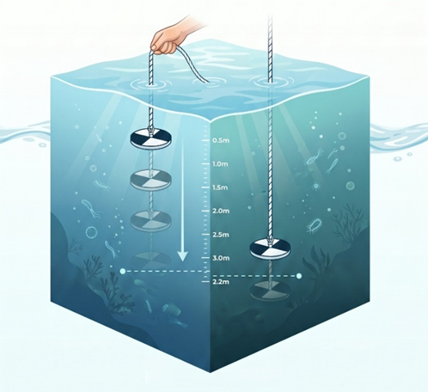
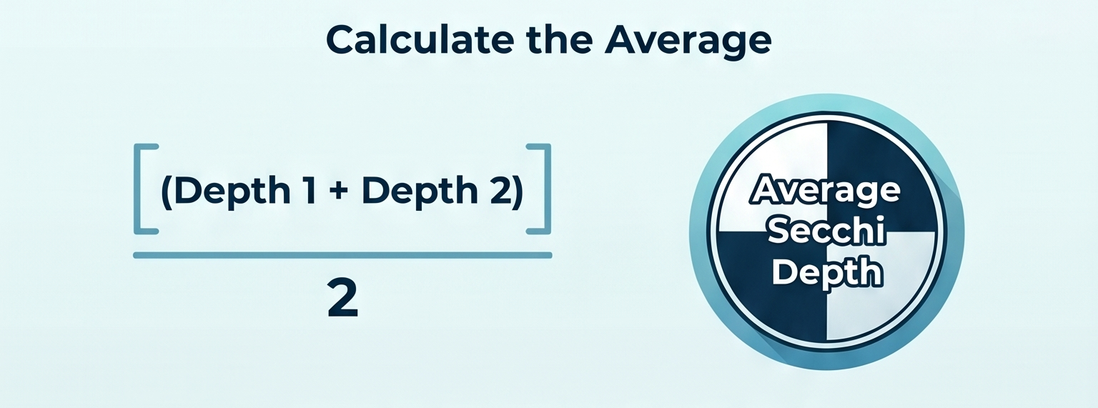
Measuring Water Clarity:
The Secchi disk is used to measure water clarity
Decreases in Secchi depth may indicate increased nutrient loading and reduced water clarity
The Secchi Depth Procedure
Remove sunglasses.
Lower disk on attached rope into water.
Lower disk until you can no longer distinguish between the white and black portions, record this depth (Depth 1 on data sheet) as indicated on the rope (rope is marked every 10 cm)
Lower the disk a little further. Slowly raise the disk until it just becomes visible again and record this depth (Depth 2 on data sheet).
The Secchi Depth is the average of these depths (Depth 1+ Depth 2) ÷ 2.
Tip: you can use clothes pegs to mark the rope. Measure the depth from the surface of the water to the Secchi Disk

Slide 26

Bacterial Analysis with ColiPlate™
The ColiPlate is a 96 microwell plate containing selective media providing nutrients to stimulate the growth of Coliforms and E.coli
The media also contains substrates which detect the enzyme specific to Total Coliform and E. coli
Providing colour change to blue to indicate Total Coliform and fluorescence to indicate E. coli
ColiPlate™ Procedure
Keep each sample refrigerated until you are about to fill the ColiPlate.
Plug in incubator and bring it up to 35° C – 37° C.
Match each sample with a ColiPlate by writing the site ID on the ColiPlate label.
Wash your hands thoroughly and use gloves if preferred.
Shake the water sample

Slide 27
ColiPlate™ Procedure
Gently pour a small stream of sample water onto the plate and fill all 96 wells. To ensure all wells are full, view the plate at eye level and top up any wells which are not full.
To remove excess water from the ColiPlate and in between wells, tilt the plate on a 90° angle and drain off.
Use a paper towel or tissue to wick away the last few drops of water at the low corner of the plate.
Viewing the surface of the plate at eye level should reveal that all wells are full, that the surface water on each well has a concave shape, and that no excess water remains on the surface (or in between the wells) of the plate.
If any wells remain unfilled, top up with a little more sample and drain off excess.
Proper drainage of water in and in between the wells of the ColiPlate is very important and ensures that cross contamination does not occur.

Slide 28
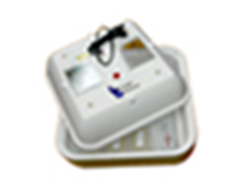
ColiPlate Incubation:
When all ColiPlates are filled place them into the incubator. Replace the lid of the incubator and allow the temperature to re-stabilize to 35 - 37° C. This may take close to an hour.
Note the time when the temperature re-stabilized.
Incubate for 24 hours from stabilization time.
Inspect the incubator several times to ensure it is remaining at the appropriate temperature and adjust if necessary. If you are using a temperature controller, set for 36° C.
After 24 hours remove the ColiPlates from the incubator.
NOTE: Do not incubate for longer than 30 hours. The media in the CoiPlate contains a reagent which inhibits the growth of non-Coliform bacteria, which becomes increasingly ineffective after that time, resulting in potential false positives.

Slide 29
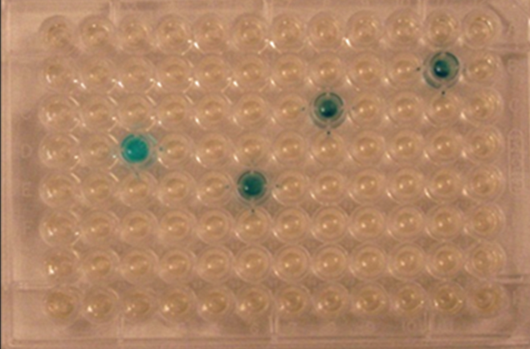
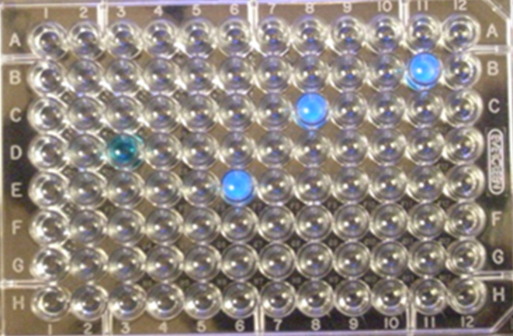
ColiPlate Enumeration:
Place the incubated ColiPlate on a white surface and count the number of wells which turned blue. This is the positive reaction for Total Coliforms (count ALL blue and blue/green wells as one count, regardless of the intensity of the colour change).
Refer to the MPN Table to determine the Most Probable Number for Total Coliforms in 100mL of sample water. Record number of blue positive wells and MPN in Data Sheet.
Place the incubated ColiPlate on a black surface in reduced light and observe under a long wavelength UV light.
Count the number of wells that turned blue and were fluorescent under the UV light. This is the positive reaction for E. coli (do not count wells with fluorescence that are not also blue – they must be blue and fluorescent).
Refer to the MPN table to determine the Most Probable Number for E. coli in 100 mL of sample water. Record number of positive blue and fluorescing wells and MPN in Data Sheet.
1. Four positive wells for Total Coliforms or 11 MPN/100mL
2. Three positive wells (fluorescing) for E. coli or 8 MPN/100mL

Slide 30
ColiPlate Clean up and Disposal:
Rinse ColiPlats and lids well. Exposed ColiPlates do not contain toxic or pathogenic materials and can be drained in a sink.
Once rinsed and excess water is removed, place ColiPlates in box and return to TGB office for recycling (bin located behind office).
Quality Control:
Additional TP bottles will be provided to select volunteers to complete Field Blanks and Duplicates.
Submission of Data:
Transfer all information on data sheet to the Excel spreadsheet on website www.bluewaterbiosciences.com/township-of-georgian-bay-sampling-program/ and email to kim.schiefer@bluewaterbioeicnes.com
Please provide the spreadsheet after each sapling event to allow any issues with results to be identified and addressed promptly.

Slide 31

Sample Data Sheet
Sample Area: Honey Harbour
Date | May 29, 2026 | Sample Time | 9:30 am
Volunteer | Allie Smith | Analysis Date & Time | May 30 at 11 am
Rainfall in last 24 hours (heavy, moderate, light, none) | heavy | Air Temp. | 18 ° C
Site Specific Data
Site ID | Water Temp | Weather (cloudy, windy) | Secchi Depth 1 | Secchi Depth 2 | Blue wells/TC | Blue wells & Flor. /EC | MPN TC | MPN EC
HH01 | 16° C | Full sun, windy | 1.9 | 2.1 | 19 | 3 | 55 | 8
HH02 | 15° C |  | 1.8 | 2.0 | 32 | 6 | 102 | 16
Comments: 12 live-aboard boats anchored within bay at HH02.

Slide 32

Next Steps: Using Data to Implement a Proactive Response
Our goal is to move beyond simply collecting and observing data toward using that information to guide meaningful, evidence-based policy and management decisions. “Move from Observation to Action”
Implementing a mandatory, data-driven response plan when parameters hit critical levels
Triggering Actions:
enhanced monitoring
public notifications / educational initiatives
septic re-inspection programs

Slide 33
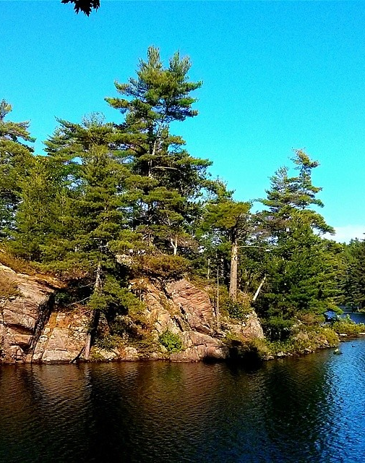
Thank you to our Volunteers!
Volunteers’ dedication and hard work are critical to this program’s success
Collecting this number of samples, at this geographic scale and frequency, would not be possible without our volunteers’ efforts
Advancing proactive, science-based and data-driven environmental stewardship
Move from simply documenting conditions in our lakes to supporting informed, data-driven actions
Helping protect the exceptional water quality of Georgian Bay and the Inland Lakes – Today and for the Future

Slide 34
Supplementary Slides

Slide 35
Understanding Trophic States
Lakes in Ontario are classified into three categories based on their nutrient levels and Trophic State Index (TSI):
Trophic State | TP Concentration | Characteristics
Oligotrophic | < 10 µg/L | Low nutrients, very clear water, high oxygen levels in deep water, and limited algae growth. Natural state for Georgian Bay/Precambrian Shield.
Mesotrophic | 11–29 µg/L | Moderate nutrient levels.
Eutrophic | > 21 µg/L | High nutrients; cloudy water associated with algal blooms (e.g., Lake Erie). Potential oxygen depletion at the bottom (which can kill fish).

Slide 36
Summary of GBWQO Exceedances in 2025 (seasonal geometric mean E. coli)
Region | Site | E. coli | Range | Threshold/Response
Gloucester Pool | GL06 Black River | 14 | >10 CFU/100mL | ALERT
Go Home Lake | GH06 Marina | 13 | >10 CFU/100mL | ALERT
Myers Lake | ML02 Lake in Swamp | 33 | >30 CFU/100mL | ACTION
Oak Bay | 1011 Golf Course Point | 14 | >10 CFU/100mL | ALERT
Oak Bay | 1011 A Trailer Park | 50 | >50 CFU/100mL | CRITICAL
Oak Bay | Island 61 | 20 | >10 CFU/100mL | ALERT
Honey Harbour | 1081 Wood’s Landing Ch. | 11 | >10 CFU/100mL | ALERT
Honey Harbour | 1107 School House Bay | 44 | >30 CFU/100mL | ACTION
Honey Harbour | 1008 N. Picnic Island Marina | 15 | >10 CFU/100mL | ALERT
Honey Harbour | 1007 Church Bay Marina | 33 | >30 CFU/100mL | ACTION
Honey Harbour | 3010 Brandy’s Island South | 12 | >10 CFU/100mL | ALERT

Slide 37
Three-tiered threshold levels Alert, Action and Critical (Greenland and Dillan)
Indicator | Threshold Level 1 ALERT | Threshold Level 2 ACTION | Threshold Level 3 CRITICAL | Mitigation Response
Total Phosphorus (MECP/PCF recommend < 20 µg/L) | > 15 µg/L (inland lakes) >10 µg/L (G.B) | > 20 µg/L (inland lakes) > 15 µg/L (G.B) | > 30 µg/L (inland lakes) > 20 µg/L (G.B) | Level 1: Enhanced Monitoring Level 2: Educational Initiatives/ Public Notification Level 3: Potential septic re-inspection
E. coli (GM of 5 samples) | >10 CFU/100mL | >30 CFU/100mL | >50 CFU/100mL | Level 1: Enhanced Monitoring Level 2: Educational Initiatives/ Public Notification Level 3: Beach Advisory, Potential septic re-inspection

Slide 38
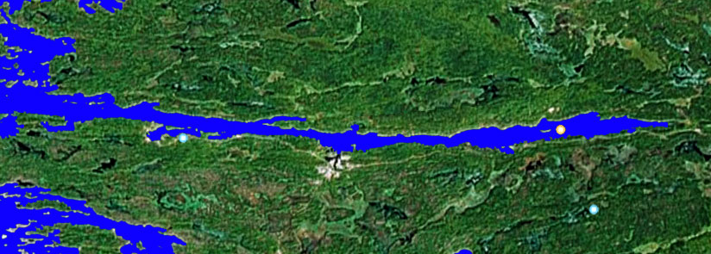
1
2
3
6
4
5
Source: Google Earth, 2007 (under Corporate License)
6.Forbes
5.Bloody Bay
4.Marina
3.Government Docks
2.Issac Bay
1.Main Channel
(control)
LEGEND
Location of Sampling Stations in Twelve Mile Bay
1
Sampling Station
Map 6.3.6

Slide 39
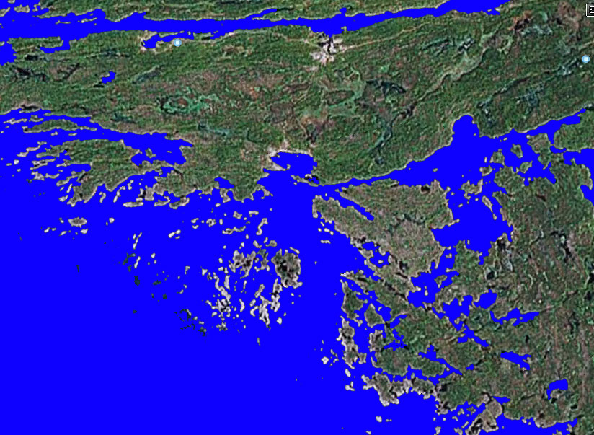
1. King Bay Marina
2. Indian Harbour
3. American Camp
4. Popular Mooring Site
5. Loriman
6. Control Site
1
6
5
1
3
2
4
Source: Google Earth, 2007 (under Corporate License)
Location of Sampling Stations in Go Home Lake (left map) and Wah Wah Taysee
LEGEND
1
Sampling Station
Map 6.3.7 and 6.3.5

Slide 40
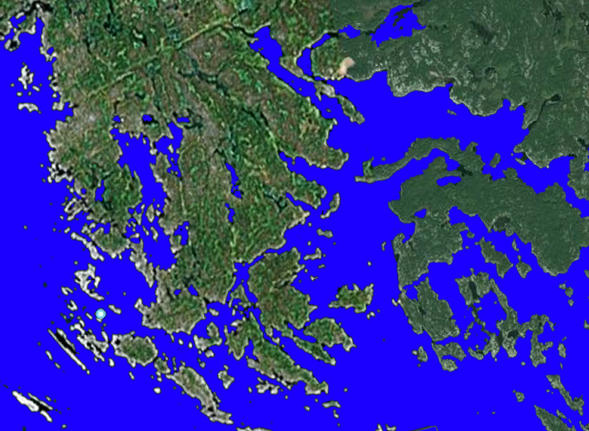
2
1. Freddy Channel
2. Longuissa Bay
3. Musquash Channel (control)
4. Arthur Island
5. Bone Island
6. Waubanoka Island
7. Cognashene Lake Narrows
8. Pike’s Bay
5
8
7
1
4
6
3
Source: Google Earth, 2007 (under Corporate License)
LEGEND
Location of Sampling Stations in Cognashene
1
Sampling Station
Map 6.3.3 and 6.3.4

Slide 41
